Slide 1
Domestic Abuse Task Force
DI Muriel Fuller

Slide 2
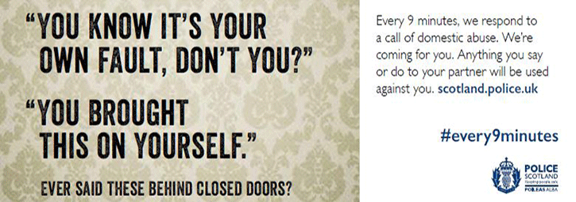
Domestic Abuse.
Developing a trauma informed approach.

Slide 3
Trauma…….
Patrick Chinskie- https://www.dailyrecord.co.uk/news/scottish-news/rapist-who-carried-out-23-year-5111247
Brian McTaggart – https://stv.tv/news/north/1429297-man-who-raped-woman-more-than-900-times-jailed-for-life/
James Gilliard –
https://www.pressandjournal.co.uk/fp/news/inverness/979502/undefined-headline-1826/

Slide 4
Domestic Abuse Task Force
The remit of the DATF is borne out of an appreciation that the term ‘Domestic Abuse’ encompasses all manner of crime types ranging from murder and rape to simple assault and breaches of the peace committed within a domestic setting. In the majority of domestic abuse cases, the crimes are perpetrated ‘behind closed doors’ and are often difficult to investigate
Violence reduction
Focus on serial abusers
Non recent offending
Serious – sexual and physical

Slide 5
How we work
Proactive approach – provides victims and survivors of domestic abuse and serious crime the opportunity to engage with the criminal justice network.
Moorov doctrine - Moorov doctrine is law which is used where the accused is charged with two or more than two separate offences and there is only one piece of identification for each of the crime, it may be possible that the accused have committed another crime in similar circumstances against someone else and the complainer can corroborate this into her evidence.
Perpetrator focussed, victim centred - The role of the Domestic Abuse Task Force (DATF) is to proactively target ‘high tariff’ perpetrators of domestic abuse; those who present the greatest risk of harm to victims and their families.

Slide 6
Statements – What happens when you ask the question.
Identify types of abuse disclosed – physical and emotional
Pick out evidence of trauma and how its shown by the victim
What implications would there be for your practice/service

Slide 7
My story – Victim account
Identify evidence of trauma and its ongoing effect
What did they say worked for them
What are the implications for your practice.

