Slide 1
Self Care

Slide 2
Vicarious Trauma
Traumatization and negative transformation of inner experience resulting from empathic engagement with the suffering and traumatic experience of others…. can result from discreet events or from cumulative exposure.
The term is often used synonymously with ‘Secondary Traumatic Stress or ‘Compassion Fatigue’

Slide 3
Burnout vs Vicarious Trauma
Burnout is a response to prolonged exposure to psychologically and emotionally stressful interpersonal situations…characterized by difficulty with empathy (emotional exhaustion), depersonalization, and reduced job satisfaction & reduced personal achievement
With Vicarious Trauma, we may still experience empathy, may still love our work, and try to push through…at great personal cost

Slide 4
Why might we be at risk?
We empathise with and often ‘absorb’ the suffering & trauma of our clients/patients
We hear extremely distressing stories
We may participate in seemingly futile and/or traumatic interventions/care
We may interact with stressed colleagues, and work in stressed and stressful environments

Slide 5
Mirroring can be helpful, but can also become burdensome
“People with a high tendency for empathy will mimic others’ mannerisms, facial expressions, posture (and thus take on emotional responses as well) more than those who test low for empathy.”(Lakin, 2003)Therefore, we “professional empaths” are at risk and must learn how to be self-aware, ‘un-mirror’ regularly, and build resilience.

Slide 6
Catch 22
Our motivation for self care is often at its lowest when we need it the most
Importance of looking out for each other/organizational culture

Slide 7
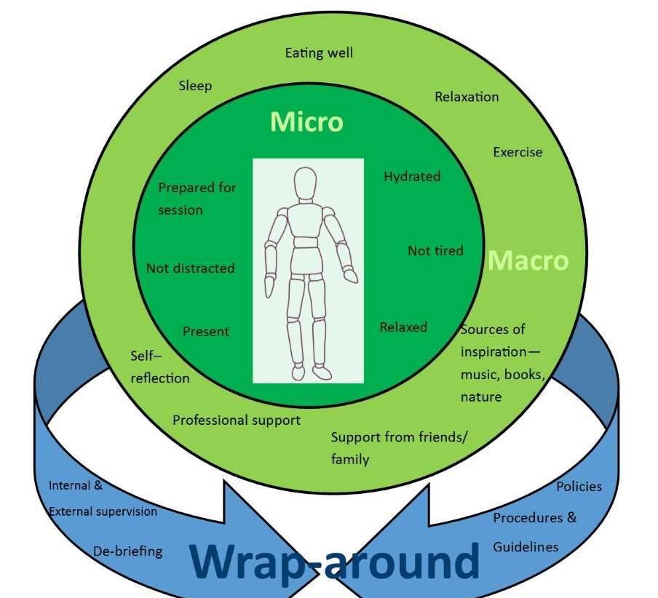
Self Care
Wrap – around
Macro
Micro

Slide 8
Wrap Around
Buddying
Debriefing
Checking in
External and internal supervision
Peer Group Supervision
Terms & Conditions (esp leave)

Slide 9
Macro
Macro Self-care should be tailored to your own areas of vulnerability (body-mind-spirit)
Social interaction
Lifestyle (nutrition, sleep, exercise)
Importance of Body Work
Multi-sensory Stimuli
Inspiration/Joy
Self Reflection
Creativity

Slide 10
Micro
Mindful awareness & intention
Breathing
Visualisations
Affirmations
Somatic Work
Sensory awareness
‘Internal supervision’

