Slide 1
Getting better at getting it right
Ann Hayne
Gender-Based Violence Manager
Notes:
1

Slide 2
What is ‘a good relationship’?
Belonging
Consent
Loved
Cared for
Valued
Encouraged
Nurtured
Sensitive
Fair
Accepted
Connected

Slide 3
Attachment Cycle (secure)
Child is distressed
They are soothed
responsively
Child is calmed
Child internalises
Self-soothing

Slide 4
GENDER BASED VIOLENCE
DOMESTIC
ABUSE
RAPE AND
SEXUAL ASSAULT
CHILD SEXUAL
ABUSE
COMMERCIAL
SEXUAL
EXPLOITATION
SEXUAL
HARASSMENT
& STALKING
HARMFUL
TRADITIONAL
PRACTICES
Central Features of GBV
Abuse of power
Betrayal of trust
Denial of the right to feel safe and valued
Loss of control, over own body and other areas of their life
Violation of personal boundaries and sense of self
Imbalance of power within society…or within a relationship

Slide 5
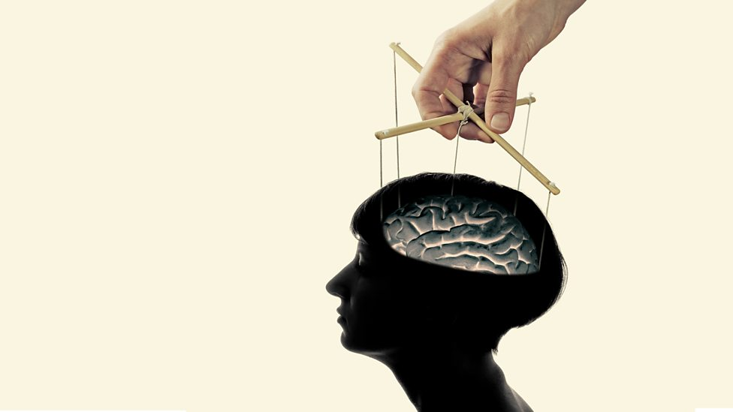

Slide 6
Coercive Control – Evan Stark
Interweave repeated physical abuse with three equally important tactics: intimidation, isolation, and control.
“Routine” in nature rather than in severity, a fact that gives abuse a “cumulative” effect found in no other assault crime.

Slide 7
Anna
Notes:
7

Slide 8
Creation of an ‘insurmountable emotional challenge’
Child is distressed
Adult is abusive or unavailable
Child is overwhelmed

Slide 9
Abuse Across the Lifespan
‘Many women describe a continuum of abuse experienced at different points in their lives, and at the hands of different abusers’ Greenan 2004
The impact over time of different types of abuse and of multiple episodes of abuse appears to be cumulative (Edwards et al 2003)
The more severe the abuse, the greater the impact on physical and mental health (Leserman et al 1996)

Slide 10
Pathways to mental health difficulties
Cognitive changes
Beliefs develop which influence how all of life and experience is viewed
Changes views/beliefs about
The world
Yourself
Other people
Common beliefs systems
‘I must be a bad person’
‘I deserve it’
‘I will be abandoned’
‘Others cannot be trusted’
‘I am incompetent’
‘Bad things will happen’

Slide 11
Partner Abuse
Sexual Assault
Child Sexual Abuse
FATAL OUTCOMES
Femicide
Suicide
Maternal Mortality
NONFATAL OUTCOMES
Continuum of
health impacts
PHYSICAL
HEALTH
Injury
Functional Impairment
Poor Subjective Health
Permanent Disability
Severe Obesity
CHRONIC
CONDITIONS
Chronic Pain Syndrome
Irritable Bowel Syndrome
Gastrointestinal Disorders
Fibromyalgia
Cancer
REPRODUCTIVE
HEALTH
Unwanted Pregnancy
STIs/HIV
Gynaecological Disorders
Unsafe Abortions
Pregnancy Complications
Miscarriage/Low Birth Weight
Pelvic Inflammatory Disease
MENTAL
HEALTH
Post Traumatic
Stress Disorder
Depression/Anxiety
Phobias/Panic Attacks
Eating Disorders
Sexual Dysfunction
Low Self-Esteem
Substance Abuse
ASSOCIATED HEALTH
BEHAVIOURS
Smoking
Alcohol and Drug Abuse
Sexual Risk Taking
Physical Inactivity
Over-Eating
Heise 1999

Slide 12
Partner Abuse
Sexual Assault
Child Sexual Abuse
FATAL OUTCOMES
Femicide
Suicide
Maternal Mortality
NONFATAL OUTCOMES
Continuum of
health impacts
PHYSICAL
HEALTH
Injury
Functional Impairment
Poor Subjective Health
Permanent Disability
Severe Obesity
CHRONIC
CONDITIONS
Chronic Pain Syndrome
Irritable Bowel Syndrome
Gastrointestinal Disorders
Fibromyalgia
Cancer
REPRODUCTIVE
HEALTH
Unwanted Pregnancy
STIs/HIV
Gynaecological Disorders
Unsafe Abortions
Pregnancy Complications
Miscarriage/Low Birth Weight
Pelvic Inflammatory Disease
MENTAL
HEALTH
Post Traumatic Stress Disorder
Depression/Anxiety
Phobias/Panic Attacks
Eating Disorders
Sexual Dysfunction
Low Self-Esteem
Substance Abuse
ASSOCIATED HEALTH
BEHAVIOURS
Smoking
Alcohol and Drug Abuse
Sexual Risk Taking
Physical Inactivity
Over-Eating
Heise 1999

Slide 13
Trauma
‘The person was exposed to: death, threatened death, actual or threatened serious injury, or actual or threatened sexual violence, as follows:
Direct exposure/witnessing, in person/indirectly, by learning that a close relative or close friend was exposed to trauma’. DSM V
‘Traumatic events are extraordinary, not because they occur rarely, but rather because they overwhelm the ordinary human adaptation to life’ Herman (1992)

Slide 14
C
Symptoms of PTSD
Sleep difficulties
Nightmares
Hyper-vigilance
Flashbacks
Panic attacks
Dissociation behaviour
Psychological fragmentation
Loss of sense of safety, trust, self-worth
Loss of coherent sense of ‘self’

Slide 15
What increases severity of PTSD?
The trauma is caused by humans rather than by a natural disaster
The trauma was caused by a known person, rather than a stranger
The experience is personal and individual, rather than shared by many
There is continued contact with the perpetrator
Trauma is repeated, rather than an isolated incident
The trauma occurs in a previously safe environment
There has been rape or sexual violence
There is little sympathetic social support
The person is targeted by more than one abuser
Women experiencing domestic violence are more vulnerable to severe and lasting post-traumatic stress reactions, especially those who remain in ongoing danger

Slide 16
Traumatic Bonding
When captives and captors develop a close emotional bond, resulting in the captive identifying themselves with their captor
This bond is pathological
It is also extremely strong
It arises from disturbances in attachment
It can affect both adults and children
It is a survival mechanism for the captive

Slide 17
What the new law says
fear, alarm and distress
violent, threatening or intimidating,
directed at B, at a child of B or at another person
(a) making B dependent on, or subordinate to, A,
(b) isolating B from friends, relatives or other sources of support,
(c)controlling, regulating or monitoring B’s day-to-day activities,
(d) depriving B of, or restricting B’s, freedom of action,
(e) frightening, humiliating, degrading or punishing B.

Slide 18
4 Evidence of impact on victim
(1) The commission of an offence under section 1(1) does not depend on the course of behaviour actually causing B to suffer harm of the sort mentioned in section 1(2).
(2) The operation of section 2(2)(b) does not depend on behaviour directed at someone actually having on B any of the relevant effects set out in section 2(3).

Slide 19
(3) Nothing done by or mentioned in subsection (1) or (2) prevents evidence from being led in proceedings for an offence under section 1(1) about (as the case may be) —
(a) harm actually suffered by B as a result of the course of behaviour, or
(b) effects actually had on B of behaviour directed at someone.

Slide 20
Working with trauma
Safety management / symptom management
Working with traumatic memories
Reconnection / community involvement
Based on Herman’s Model of Trauma Recovery 1992

Slide 21
Court interaction and therapy
National agencies organisation position
Therapist position
Court position

Slide 22
Ann Hayne
Gender-Based Violence Manager
Operational Adviser for NHS Lanarkshire
01236 707767
ann.hayne@lanarkshire.scot.nhs.uk

